Slide 1
CS601-Data Communication
VU
LECTURE #1
Course Outline
*The course will consist of :
–45 lectures
–10-14 assignments
–2exams (1 midterm and 1 final)
–GMDB
*Grading Criteria:
–One Midterm: 35 %
–Final Exam: 45%
–Assignments: 15%
–GMDB: 5%
Textbook
*“Data Communications and Networking” 4th Edition by Behrouz A. Forouzan
*“Data and Computer Communication” 6th Edition by William Stallings

Slide 2
CS601-Data Communication
VU
INTRODUCTION TO DATA COMMUNICATION
DEFINITION OF DATA COMMUNICATION
“Data Communication is the exchange of Information from one entity to the other using a Transmission Medium”.
DEFINITION OF DATA COMMUNICATION (Cont’d)
As you can clearly notice, the definition of Data Communication although Simple leaves many questions unanswered:
Exchange??????
Information?????
Entities???????
Transmission????
Medium????
We will try to answer all these Questions in this Course
History of Data Communication
Data communications history represents a blend of histories, including:
The history of the telecommunications industry
The history of data communications, and
The history of the Internet
Telegraph 1837 Samuel Morse
Modern telecommunication industry began in 1837 with the invention of the telegraph by Samuel Morse
This led to building a telecommunications infrastructure of poles and wires as well as to the development of communication hardware and protocols
Telephone 1876 Alexander Graham Bell
Invention of telephone by Alexander Graham Bell in 1876 and the development of wireless communication technology by Guglielmo Marconi in the 1890s set the stage for today’s communication industry
❖ By 1950’s
By 1950s, telephone and telegraph companies had developed a network of communication facilities throughout the industrialized world
❖ 1970’S
Although development of databases, languages, operating systems, and hardware was strong from 1950s to 1970s, large-scale data communication systems did not emerge until the 1970s.
This was stimulated by 3 major developments:
Large-scale integration of circuits reduced cost and size of terminals and communication equipment

Slide 3
CS601-Data Communication
VU
New software systems that facilitated the development of data communication networks
Competition among providers of transmission facilities reduced the cost of data circuits
TODAY’S EVERGHANGING & BUSY WORLD
Today’s fast world demands better, secure and most of all FAST ways of communication
Gone are the days when you had to wait a couple of weeks to get a letter from
USA
Why wait ONE week when you can get the information you require in just a split of a second, using what we know by the name of “DATA COMMUNICATION”.
HOW TO ACHIEVE THIS?
How to achieve this ACCURACY, SECURITY and SPEED for the transfer of this information?
What HARDWARE and the SOFTWARE is needed?
And, what should be the MEANS of sending this info?
ARE SOME OF TOPIC WE WILL BE EXPLORING DURING THE COURSE OF OUR STUDY
DATA COMMUNICATION
When we communicate , we share information
Information can be LOCAL or REMOTE
Between Individuals LOCAL communication occurs face to face
REMOTE communication occurs over a long distance
When we refer to COMPUTER SYSTEMS, Data is represented in the form of Binary Units (Bits) in the form of Zeros (0’s) and One’s (1’s)
Also the entities can most of the times be considered to be COMPUTERS
Data Communication Definition (Modified)
Therefore, our earlier definition can easily be modified to:
“Data Communication is the exchange of data (in the form of 0’s and 1’s) between two devices (computers) via some form of the transmission medium.”
LOCAL and REMOTE Data Communication
LOCAL
Data communication is considered to be local if the communicating devices are present in the same building or a similarly restricted geographical area

Slide 4
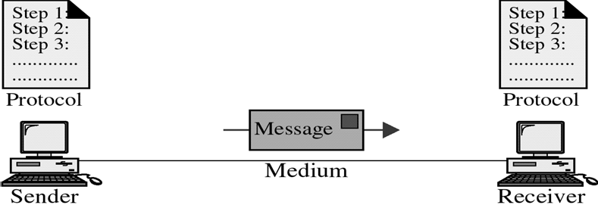
CS601-Data Communication
VU
REMOTE
Data Communication is considered remote, if the devices are farther apart.
VAGUE DEFINITIONS
We will clarify
Data Communication System
For Data Communication to occur, the communicating devices must be a part of a communication system made up of some specific kind of hardware and software
This type of a system is known as a
“DATA COMMUNICATION SYSTEM”
Effectiveness of Data Comm. System
Effectiveness depends upon three fundamental characteristics:
Delivery
Accuracy
Timeliness (Better NEVER than LATE)
Example of the POSTAL MAIL
Components of Data Comm. Systems
Components of Data Com Systems
Any system is made up of more than one component. Similarly, a data communication system is made up of 5 components as shown in the fig:
Message
Sender
Receiver
Medium
Protocol

Slide 5
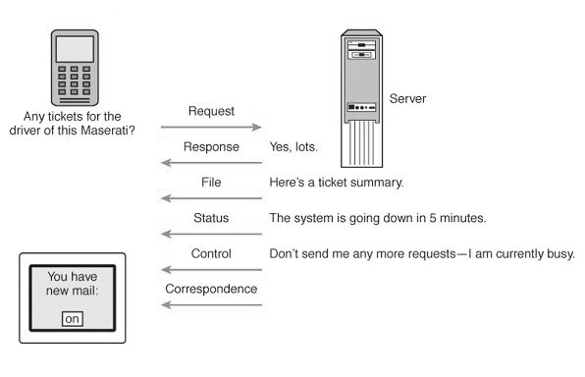
CS601-Data Communication
VU
MESSAGE
Information or Data to be communicated
Can be text, numbers, video or any combination of these
In short anything that can be represented using binary bits
Data Communication Messages
Files (meaningful collections of records)
Data/information requests (database queries, Web page requests, etc.)
Responses to requests and commands or error messages
Status messages (about the network’s functional status)
Control messages transmitted between network devices to control network traffic
Correspondence among network users
MESSAGE TYPES
❖ SENDER
SENDER
Device that sends the data message
Can be a Computer , Workstation, Video camera etc
As already discussed, the data from the sender might not be in the appropriate format for the transmission medium and will need to be processed
RECEIVER
Device that receives the message
Can be a computer, workstation, Television etc
At times, the data received from the transmission medium may not be in a proper form to be supplied to the receiver and it must be processed

Slide 6
CS601-Data Communication
VU
MEDIUM
Physical path that a message uses to travel from the Sender to the Receiver
Can be a Copper Cable (Telephone), Coaxial Cable (Cable TV), Fiber Optic Cable, LASERS or Radio Waves (Wireless Medium)
We will see that Data needs to be transferred in the form of ELECTROMAGNETIC signals and The Transmission Medium should be capable of carrying these EM Signals
Transmission Media
Transmission Media
Medium | Speed | Cost
Twisted Wire | 300bps-10Mbps | Low
Microwave | 256Kbps-100Mbps | Low
Coaxial Cable | 56Kbps-200Mbps | Low
Fiber Optic Cable | 500Kbps-10Gbps | High
PROTOCOL
Set of Rules Governing Communication
Represents an Agreement between communication devices
Without Protocol, two devices may be connected but they will not be able to communicate
EXAMPLE: Consider the communication between two individuals. They can only communicate provided they both speak the same language.
A little more complex Comm. System

Slide 7
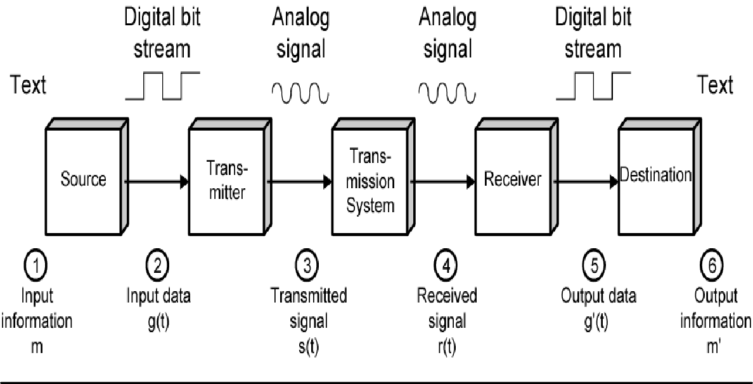
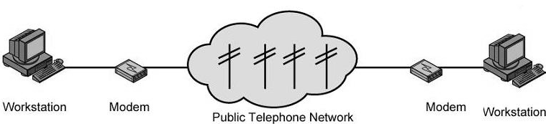
CS601-Data Communication
VU
EXAMPLE – ELECTRONIC MAIL
Explanation In Terms of a little more complex Comm. System
❖ SENDER SIDE
➢ Input device and transmitter are components of a Personal Computer
User of a PC wishes to send a message ‘m’
User activates electronic mail package e.g. hotmail
Enters the message via input device (keyboard)
Character string is buffered in main memory as a sequence of bits ‘g’
PC is connected to some trans system such as a Telephone Network via an I/O Transmitter like Modem
Transmitter converts incoming stream ‘g’ into a signal ‘s’
RECEIVER SIDE
The transmitted signal ‘s’ is subject to a number of impairments depending upon the medium
Therefore, received signal ‘r’ may differ from ‘s’.
Receiver attempts to estimate original ‘s’ based on its knowledge of the medium and received signal ‘r’
Receiver produces a bit stream g’(t)
Briefly buffered in the memory
Data is presented to the user via an output device like printer, screen etc.

Slide 8
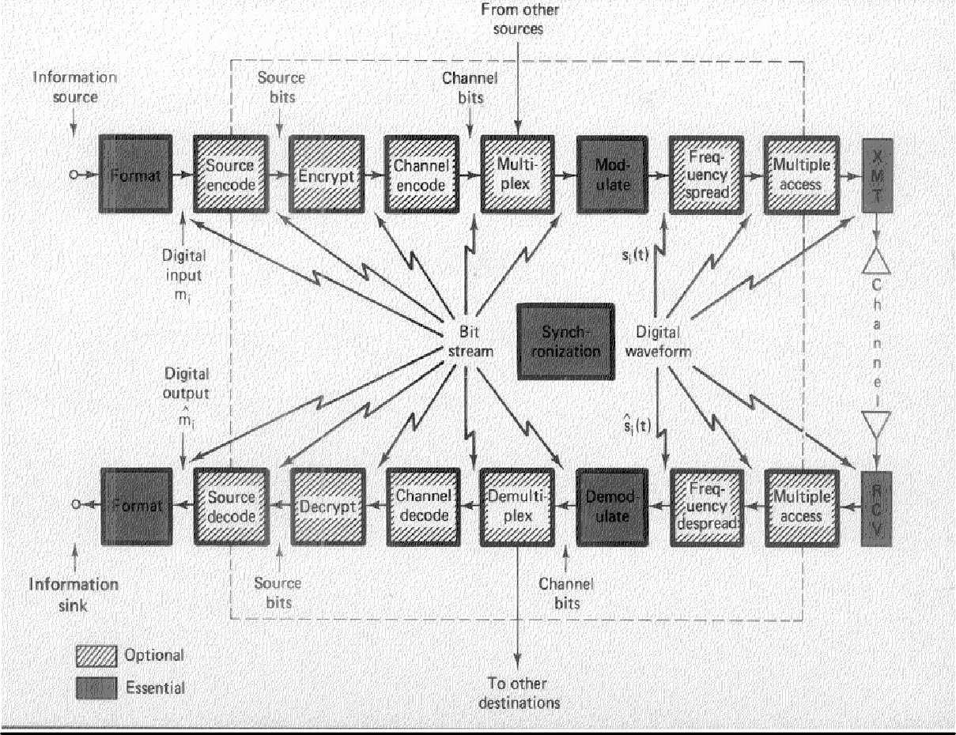
CS601-Data Communication
VU
The data viewed by user m’ will usually be an exact copy of the data sent ‘m’
EXAMPLE-Telephone System
Input to the Telephone is a message ‘m’ in the form of sound waves
The sound waves are converted by telephone into electric signals of the same frequency
These signals are transmitted w/o any modification over the telephone line
Hence g(t) and s(t) are identical
S(t) will suffer some distortion so that r(t) will not be the same as s(t)
o
R(t) is converted back to sound waves with no attempt of correction or improvement of signal quality
o Thus m’ is not an exact replica of m
An Actual Digital Data Communication System Key Data Communication Terminology
Session: communication dialog between network users or applications Different Types of this session for Info Exchange
Network: interconnected group of computers and communication devices We will look into it in a little bit
Node: a network-attached device Node can be any device in the network

Slide 9
CS601-Data Communication
VU
Summary
Data Communication
Brief History of Communication
Data Communication System
Key Data Communication Terminology
Reading Sections
Section 1.2, “Data Communications and Networking” 4th Edition by Behrouz A. Forouzan
Sections 1.1, 1.2, “Data and Computer Communication” 6th Edition by William Stallings

Slide 10
CS601-Data Communication
VU
LECTURE #2
KEY DATA COMMUNICATION TERMINOLOGY
Link: connects adjacent nodes
Wires, Cables, Any thing that physically connects two nodes
Path: end-to-end route within a network
Circuit: the conduit over which data travels
Packetizing: dividing messages into fixed-length packets prior to transmission over a network’s communication media
Routing: determining a message’s path from sending to receiving nodes
The transmission medium may itself be a network, so route needs to be specified
Network
“A NETWORK is a set of devices (Nodes) connected by Communication Links”
Node: Can be a Computer, Printer or any other device capable of sending or receiving
The links connecting Nodes are called COMMUNICATION CHANNELS Networks- Why we need them?
Networks- Why we need them?
It is often impractical for devices to be directly connected for two major reasons:
The devices are very far apart. They are expensive to connect just two devices with one in Lahore and other in Islamabad
Large set of devices would need impractical number of connections e .g. Telephone Lines in the world and all the computers owned by a single organization
Solution to the Problem=Networks
Solution is to connect all devices to a central system known as a NETWORK in which all terminals or computers share the links.
Two Main Classifications of the Networks

Slide 11
CS601-Data Communication
VU
LANS
WANS
DISTRIBUTED PROCESSING
Instead of a single large machine being responsible for all aspects of a process , each separate computer handles a subset of the task
Example – Project Given as a part of the Course
Example – Office Work
Advantages of Distributed Processing
Security
A system designer can limit the kind of interaction that a given user can have with the entire system.
For example : Bank’s ATM
Distributed Data bases
No one system need to provide storage capacity for the entire database
For example WWW gives user access to pages stored anywhere on Internet
Faster Problem Solving
Multiple computers working on a problem can solve a problem faster than a computer working alone
Security through Redundancy
Multiple computers running the same program provide security through redundancy
If one computer hardware breaks down then others cover up.
Collaborative Processing
Both multiple computers and multiple users can interact for a task
Network Criteria

Slide 12
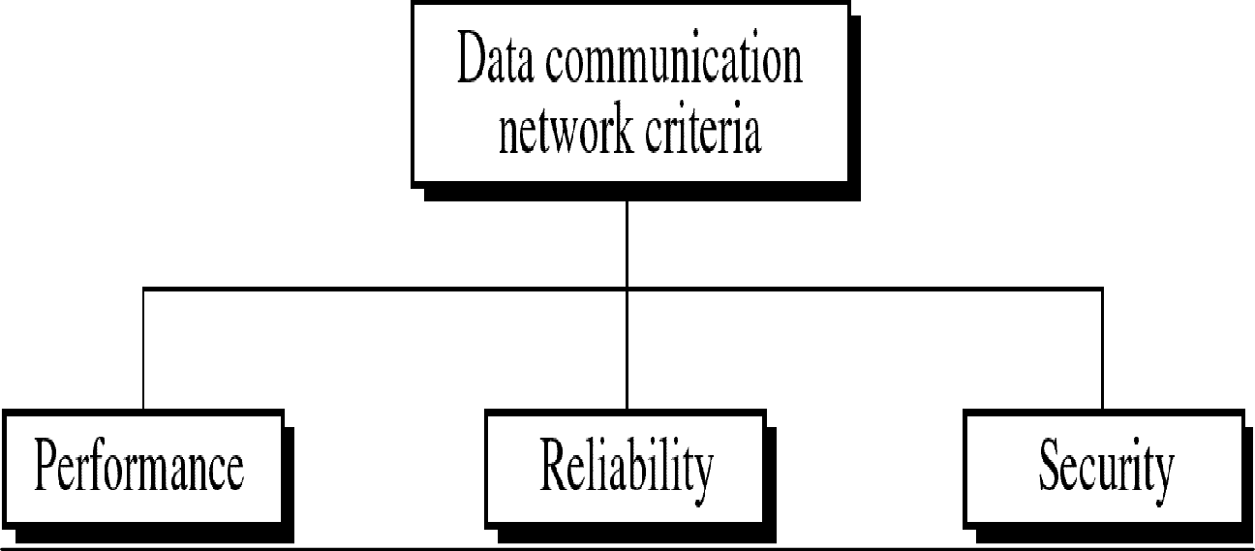
CS601-Data Communication
VU
Performance
Can be measured in many ways including Transit and Response Time
Depends on a no. of Factors:
Number of USERS
Type of Transmission Medium
Hardware
Software
Network Criteria
Number of USERS
Large Number of concurrent users slow network
Design of a network
Peak Load Periods
Network Criteria
Type of Transmission Medium
Medium defines speed at which data can travel
Fiber Optic Cable
100Mbps and 10 Mbps
Hardware
Software
Hardware
Effect speed and the capacity of transmission
Fast computer with large storage capacity
Software
Network Criteria
Software

Slide 13
CS601-Data Communication
VU
Software processes data at sender , receiver and intermediate nodes
All communication steps need software:
Moving message from node to node
Transforming,
Processing at the sender and receiver
Error Free Delivery
Well designed software can speed up the process
Reliability
Depends on a no. of Factors:
Frequency of Failure
Recovery Time of a Network after Failure
Catastrophe
Fire , Earthquake or Theft
Security
Unauthorized Access
Sensitive data
Protection at multiple levels:
Lower level: Passwords and user ID codes
Upper Level: Encryption
Viruses
Network Applications
Marketing and Sales
Marketing
Collect, exchange and analyze data relating to the customers needs
Product development cycles
Sales
Tele shopping,
On line reservation systems
Financial Services
Online Banking
Foreign Exchange Transfers
Rates
Manufacturing

Slide 14
CS601-Data Communication
VU
Computer Aided Design
Computer Assisted Manufacturing
Network Applications
Electronic Messaging
Teleconferencing
Conferences to occur w/o participants at the same place
Chat
Voice Conferencing
Video Conferencing
Cable Television
Summary
Key Data Communication Terminology
Networks and why we need them?
Distributed Processing
Network Criteria
Network Applications
Reading Sections
Section 1.3, “Data Communications and Networking” 4th Edition by Behrouz A. Forouzan
Sections 1.3, “Data and Computer Communication” 6th Edition by William Stallings

Slide 15
CS601-Data Communication
VU
LECTURE #3
Communication Tasks
There are some key tasks that must be performed in a data communication system Elements can be added, deleted, or merged together
Transmission System utilization | Interfacing
Signal Generation | Synchronization
Exchange Management | Error Detection and Correction
Flow Control | Addressing
Routing | Recovery
Security | Network Management
Transmission System Utilization
Need to make efficient use of Transmission facilities that are shared among a no. of communicating devices
For Example:
Techniques like Multiplexing to allow multiple users to share total capacity of a Transmission Medium
Congestion Control: TX. System should not be overwhelmed by traffic
Interfacing
A device must have an Interface with the Transmission System/Transmission Medium
Signal Generation
Electromagnetic Signals travel over Transmission Medium. Once an interface is established, Signal generation is required
Properties of Signals
Capable of being propagated over TX. Medium
Interpretable as data at the Receiver
Synchronization
The transmission and the reception should be properly synchronized. Synchronization means that the receiver must be able to determine, when to

Slide 16
CS601-Data Communication
VU
expect a new transmission and when to send acknowledgements. In other words transmitter and receiver should have an agreement on the nature as well as timing of the signals
Exchange Management
If the data needs to be exchanged in both directions over a period of time, both parties must cooperate as follows
Whether both devices must transmit simultaneously or take turns
Amount of Data to be sent at one time
Format f the Data
What to do when an Error Arises
Error Detection and Correction
In all comm. Systems, there is a potential risk for errors and impairments.
Tx. Signals are distorted to some extent before reaching their destination. Error Detection & Correction needs to be employed in Data Processing Systems where a change in say the contents of a file cannot be tolerated
Flow Control
To make sure that source does not overwhelm destination by sending data faster than it can be handled and processed
Addressing & Routing
If TX facility is shared by two or more devices, source must specify the identity or the address of the destination system and if Tx. System is itself a system, a proper route must be allocated that the data will take in order to reach the desired destination
Recovery
If a data transmission is interrupted due to a fault somewhere in the system, recovery techniques are needed. The objective is either to resume activity at the point of interruption and to restore the state of the system to what it was prior to the interruption
Security
Security is very important issue in a Data Communication System. The sender needs to be assured that
Only the Intended receiver receives the data
Data is delivered unaltered
Introduction to Protocol
In computer Networks, communication occurs between two entities in different systems.
Entity is anything sending and receiving information
SYSTEM is a physical object containing more than one entities

Slide 17
CS601-Data Communication VU
Now, two entities in different systems cannot just send data and expect to be understood. For communication to occur, these entities must agree on a PROTOCOL
PROTOCOLS
As discussed earlier, “Protocol is a set of rules governing communication”
Two computers cannot just send bit streams to each other and expect to be understood
Entities must agree on a PROTOCOL
Same Example French and German
Protocol defines:
What is Communicated?
How it is Communicated?
When it is Communicated?
KEY elements of a PROTOCOL
Syntax:
Represents the Structure or the format of the Data
Meaning the order in which data is presented
For Example
First eight bits to be Sender address
Next eight to be Receiver’s Address
The Rest to be Data
Semantics:
Refer to the Meaning of each section of bits
How is a particular pattern to be interpreted?
What action should be taken based on interpretation?
For Example
Does an address identify the route to be taken or the final destination of the message?
Timing
Refers to 2 characteristics:
When data should be sent?
How fast it should be sent?
For Example
If sender produces data at 100 Mbps
But Receiver can only process data at 1 Mbps
The TX. will overload receiver and data will be lost

Slide 18
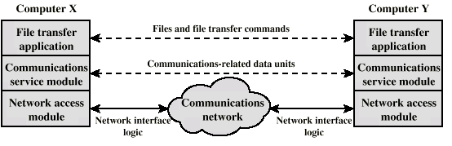
CS601-Data Communication
VU
Protocol Architecture
Instead of having a single Module for performing communication, there is a structured set of modules that implement communications function”
This structure is called Protocol Architecture
Let’s explain it by an example of File transfer system.
Simplified File Transfer Architecture
•
In the above example File transfer could use three modules
File transfer application
Communication service module
Network access module
File transfer application
File Transfer contains all of the logic is unique to the file transfer application such as:
Transmitting passwords
File Commands
Checking File System on other machine if it is ready
Check File System Compatibility
File records
Communication service module
Instead of allowing File Transfer Module to deal with actual transfer of data and commands, we can have a separate module for this transfer. This module must make sure that the receiver system is ready to receive and look into the reliable exchange of data
Network access module
Nature of the exchange between systems is independent of the network that connects them. That allows us to have a 3rd module that handles the details of the Network interface and interacts with the network. If Network to be used changes, only Network access Module has to change

Slide 19
CS601-Data Communication
VU
Characteristics of a Protocol
Direct or indirect
Monolithic or structured
Symmetric or asymmetric
Standard or nonstandard
Direct
Systems share a point to point link or
Data can pass without intervening active agent
Simple Protocol
Indirect
Switched networks or
Interne works or internets
Data transfer depend on other entities
Complex Protocol
Monolithic or Structured
Communications is a complex task
To complex for single unit
Structured design breaks down problem into smaller units
Layered structure
Symmetric or Asymmetric Symmetric
Communication between peer entities
Asymmetric
Client/server
Standard or Nonstandard
Nonstandard protocols built for specific computers and tasks
Summary
Communication Tasks
Protocols
Protocol Architecture
Characteristics of a Protocol
Reading Sections
Section 1.4 “Data Communications and Networking” 4th Edition by Behrouz A. Forouzan
Sections 1.1,2.1 “Data and Computer Communication” 6th Edition by William Stallings

Slide 20
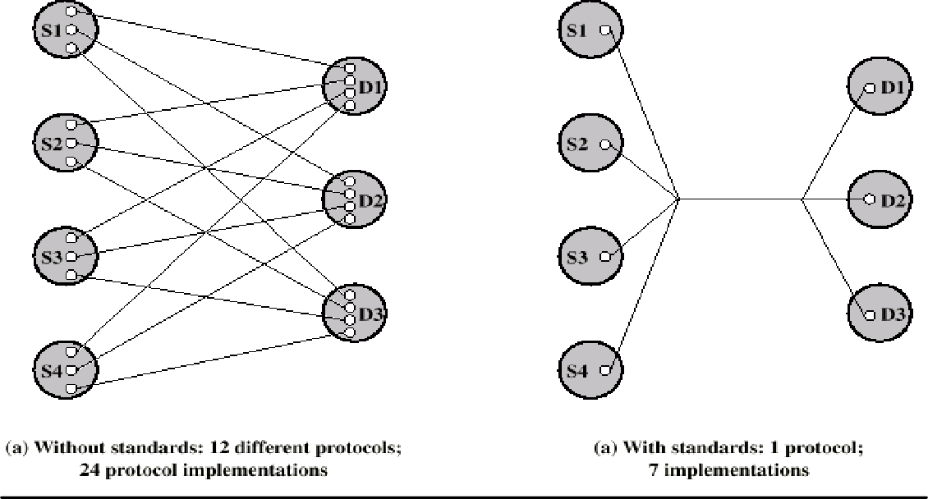
CS601-Data Communication
VU
LECTURE #4
Standards
“A standard provides a model for development that makes it possible for a product to work regardless of the individual manufacturer|”
A great deal of coordination and cooperation is required by the devices to communicate
A device prepared by a specific manufacturer may not be compatible with the devices prepared by other manufacturers
Unavailability of standards creates problems and puts a halt to product growth
An example of non-standardized products is AUTOMOBILES
Why Standards are Essential?
Standards are therefore essential in:
o Creating and Maintaining an Open and competitive Market Manufacturers
for Equipment of Data and
o Guaranteeing National and International Interoperability
Telecommunications Technology and Equipment
Let us understand this using an EXAMPLE
NOTE
K sources and L receivers leads to K*L protocols and 2*K*L implementations
If common protocol used, K + L implementations needed

Slide 21
CS601-Data Communication
VU
Categories of Data Communication Standards
Standards
De jure (By Law)
De facto (By Fact)
Proprietary
Non Proprietary
De facto (By fact or By Convention)
Standards not approved by an organized body but have been adopted as standards through their widespread use
De jure (By Law or By Regulation)
Standards that have been legislated by an officially recognized regulation body Subdivision of De Facto Standards
PROPRIETARY (Closed Standards)
Standards that are originally invented by a Commercial Organization as a basis for the operation of its products they are wholly owned by that company. They are also called Closed Standards because they close off Communication between systems
NON- PROPRIETARY (Open Standards)
They are originally developed by groups or committees that have passed them into public domains. They are also called Open Standards because they open Communication between different systems
Standard Organizations
Standards are developed mainly by 3 entities:
Standard Creation Committees
Forums
Regulatory Agencies

Slide 22
CS601-Data Communication
VU
Standard Creation Committees
They are Procedural Bodies and they are so slow moving and cannot co-op with the fast growing communication industry.
ISO
International Standard’s Organization
Voluntary Organization
Created in 1947
Members are from Standard Creation Committees of different countries
Includes representatives from 82 countries
Open System Interconnection (OSI) Model
ITU-T
By 1970s a lot of countries were defining standards but there was no International compatibility
United Nations made as a part of their ITU
Consultative Committee for International Telegraphy and Telephony (CCITT)
IN 1993 , ITU-Telecomm Standards Sector
Important ITU-T Standards
V Series (V32, V33, V42, Define Data Transmission over phone lines
X Series(X.25, 400, 500): Define Transmission over Public Digital Network
ISDN: Integrated Services Digital Network
The American National Standard Institute (ANSI)
Private-Non Profit Cooperation not affiliated with US Government
Members include professional societies, industrial associations, govt. and regulatory bodies
Submits proposal to ITU-T and is a voting member for USA in ISO
The Institute of Electrical and Electronics Engineers (IEEE)
Largest professional engineering society in the world
Also oversees the development of Telecommunication and Wireless International Standards
Special committee for LANS out of which emerged Project 802 (802.3, 802.4, 802.5)
Forums
Special Interest Groups with representatives from interested corporations they facilitate and fasten standardization process by working with universities, and users to test, evaluate and standardize new technologies

Slide 23
CS601-Data Communication
VU
Each Forum Concentrate on a specific technology and present their conclusions to the standard bodies
Frame Relay Forum
ATM Forum
Internet Society & IETF
Regulatory Agencies
All communication technology is subject to regulation and laws by government agencies. The purpose is to protect Public Interest by regulating Radio, Television and Cable Communications.
FCC
Before we go into the details of how data are transmitted from one device to the other, it is important to understand:
The relationship between communication devices.
How the devices connect with each other in a System?
How do they do the exchange of information?
Five Concepts provide the basis
Line Configuration
Topology
Transmission Mode
Categories of networks
Internetworks
LINE CONFIGURATION
“Line Configuration refers to the way two or more devices attach to a Link”
A link is the physical communication path that transfers data from one device to the other. Link can be thought of as a Line drawn between two points. For communication to occur, two devices must be connected to each other using a link.
Line Configurations

Slide 24
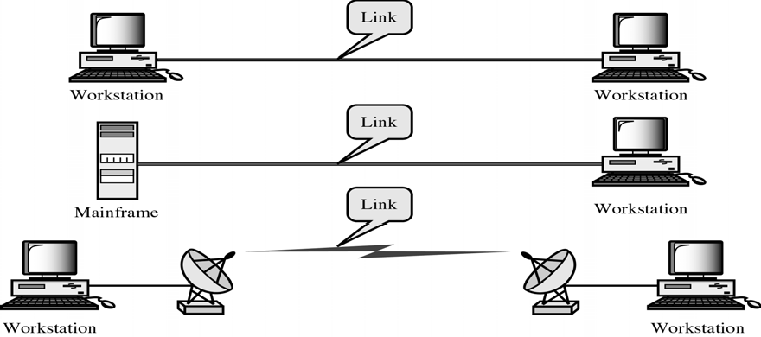
CS601-Data Communication
VU
Line Configuration
Point-to-Point
Multipoint
Spatially Shared
Time Shared
Point-to-Point Line Configuration
Dedicated Link between two devices. Entire Capacity of the channel is reserved for TX B/w these two devices. Mostly point-to-point connection use wire/cable to connect with each other. But Microwave, Satellite Links can also be used
Data and Control information pas directly between entities with no intervening agent
Examples:
TV Remote Control and TV Control Systems
Mobile Phone (when talking) and Base Station (Antenna)
Multipoint Line Configuration
More than two devices share the Link that is the capacity of the channel is SHARED now. With shared capacity, there can be two possibilities in a Multipoint Line Config:
Spatial Sharing: If several devices can share the link simultaneously, its called Spatially shared line configuration

Slide 25
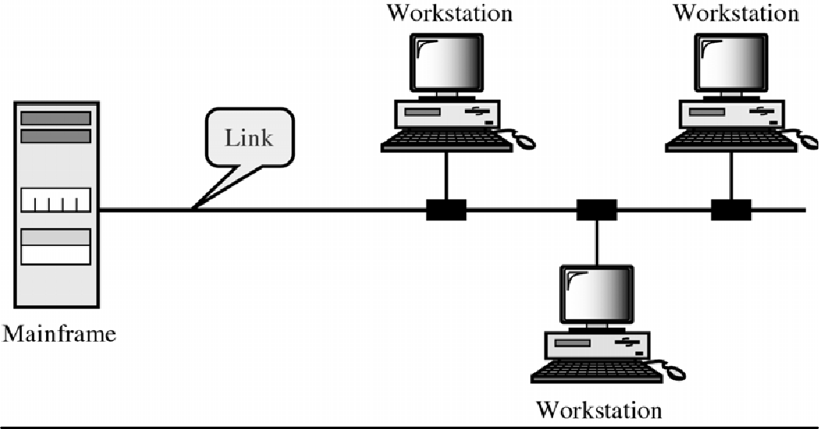
CS601-Data Communication
VU
Temporal (Time) Sharing: If users must take turns using the link , then its called Temporally shared or Time Shared Line Configuration
Summary
Standards
Standard Organizations
Line Configuration
Categories of Line Configuration
Reading Sections
Section 1.5,2.1 “Data Communications and Networking” 4th Edition by Behrouz
Forouzan

Slide 26

CS601-Data Communication
VU
LECTURE #5
TOPOLOGY
“The Topology is the geometric representation of the relationship of the links and the linking devices (Nodes) in a Network”
Or
“Topology defines the physical or the Logical Agreement of Links in a Network”
Topology of a Network is suggestive of how a network is laid out. It refers to the specific configuration and structure of the connections between the Links and the Nodes. Two or more devices connect to a Link and two or more Links form a Topology
Categories of TOPOLOGY
Topology
Mesh
Star
Tree
Bus
Ring
Question: What to consider when choosing a Topology????????
Answer: Relative status of the devices to be linked.
Two relationships are possible in a network
PEER-TO-PEER: Devices share the link equally
PRIMARY-SECONDARY: One device controls traffic and the others must transmit through it

Slide 27
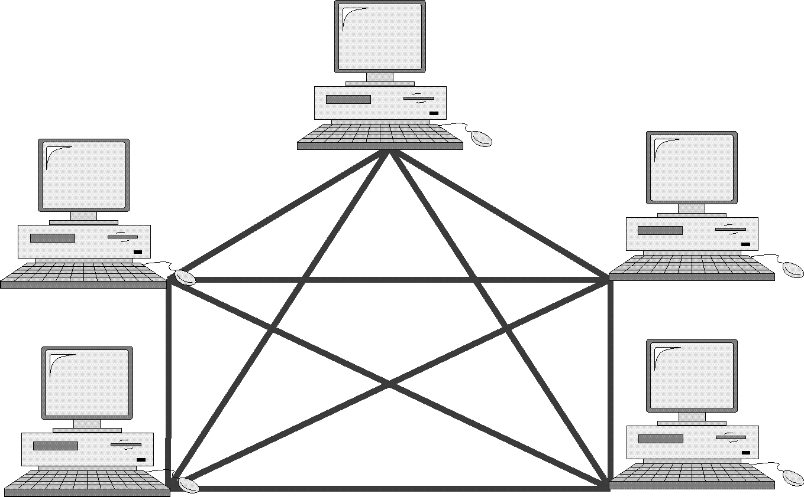
CS601-Data Communication
VU
MESH TOPOLOGY
Every device has dedicated a point-to-point link to every other device
Dedicated: Means that the link carries traffic only between these two devices
o Each device must have
n −1
I/O Ports
_{n(n −1)/2} link in the system
In figure above, we have 5 Nodes, therefore:
✓ No. of Links= 5(5-1)/2 = 10
No. of I/O Ports= 5-1 = 4
This increase exponentially with increase in No. of Nodes
e.g. for 6 nodes = 15 Links
7 Nodes=21 Links
Advantages of Mesh Topology
Use of Dedicated links guarantees that each connection can carry its own load. This eliminates Traffic Problems as in case of Shared Link
Mesh Topology is robust. If one link fails, it does not effect other links
Security & Privacy due to dedicated links
Point – to –Point links make Fault Identification easy
Disadvantages of Mesh Topology
Amount of Cabling
Makes Installation & Reconfiguration difficult
Sheer bulk of wiring can be greater than the available space
Number of I/O Ports Required
Hardware required to connect each link can be prohibitively expensive

Slide 28
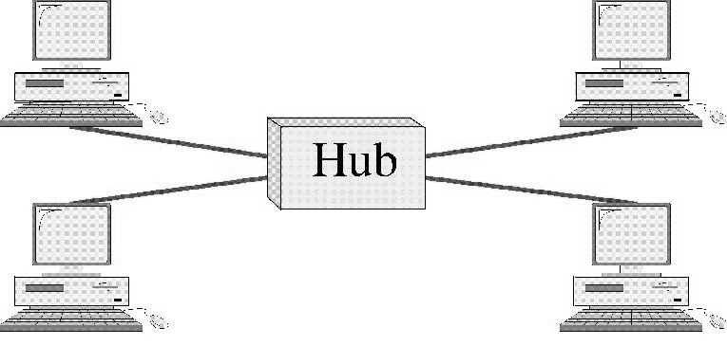
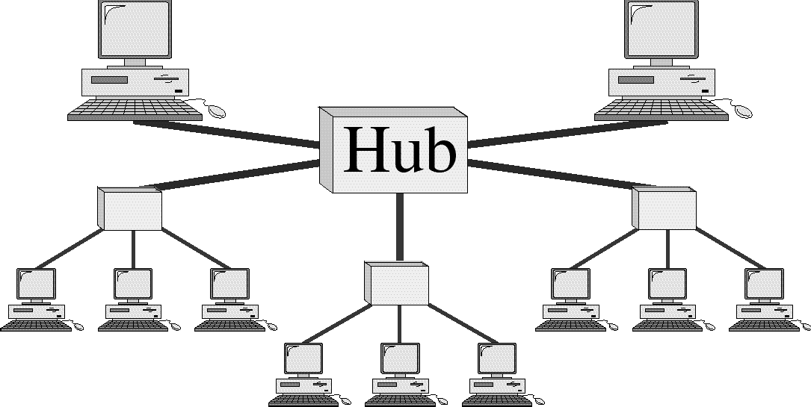
CS601-Data Communication
VU
Therefore, Mesh topology has limited use
Star Topology
Each device has a dedicated point-to-point link to a central controller ( Hub)
Devices are not directly connected to each other
Controller (Hub) acts as an exchange
If one device wants to send data to the other, it sends the data to the controller , which then relays it to the other connected device
Advantages of Star Topology
Less Cabling
Less Expensive than Mesh as each device need sonly one link and one I./O Port
Easy to Install and Reconfigure
Robust, if a link fails , only that link fails
Easy Fault Detection
Disadvantages of Star Topology
Although Cabling required is far less than Mesh
Still each node must be connected to a Hub , so Cabling is still much more than some other Topologies
Tree Topology
o A variation of Star Topology
30

Slide 29
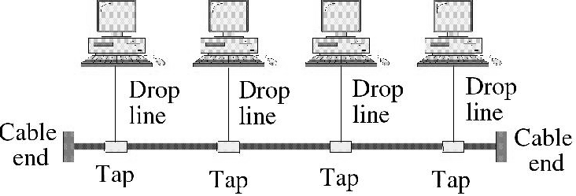
CS601-Data Communication
VU
Nodes in a Tree are linked to a central hub that controls the traffic to and from network
Difference b/w star and tree is not all the devices plug directly into the central HUB
Majority connects to secondary hub that is connected to central hub
CENTRAL HUB in Tree Topology
Central Hub in a Tree is an ACTIVE HUB
ACTIVE HUB contains a repeater
Repeater is a hardware device that regenerates the received bit pattern before sending them out.
Repeater strengthens TX. And increases the distance a signal can travel
Secondary HUB in Tree Topology
Secondary Hub in a Tree may be Active or Passive HUB
Passive Hub simply provides physical connection between attached devices
Advantages of Tree Topology
Because of Secondary Hub, More devices can be attached to a Central Hub and therefore increase the distance a signal can travel
Enables Differentiated Services: Allows to prioritize communication, e.g. computers attached to one secondary hub can be given priority over others
Therefore, TIME SENSITIVE data will not have to wait for access to the network
Rest of the advantages are almost the same as STAR
Example Tree Topology: Cable TV
CABLE TV
–Main cable from main office is divided into many branches and each branch is divided into smaller branches and so on
–Hubs are used when cable is divided
BUS TOPOLOGY
o All the previous topologies describe Point-to-point communication
o Bus Topology is Multipoint
o One long cable acts as a BACKBONE to link all devices in the network

Slide 30
CS601-Data Communication VU
Drop Lines and Taps
Drop Line is the connection between device and the main cable (Backbone)
Tap is a connector that;
Splices into the main cable or
Punctures the sheathing of a cable to create connection with the metallic core
Signal degrades as it travels, therefore there is a limit on:
The number of Taps a Bus can support and
The distance between those Taps
Advantages of BUS TOPOLOGY
Easy to install
Backbone can be laid on the most efficient path and then rest of the nodes can be connected using Drop Lines
Less cabling than Mesh , Star or Tree
Disadvantages of BUS Topology
Difficult Reconfiguration
Difficult to add new devices
adding new devices may require modification of backbone
No Fault Isolation
A fault or break in backbone can disable communication even on the same side of the problem
Damaged area reflects signals back in the direction of origin creating Noise in both directions
Summary
Topology
Categories of Topologies
Reading Sections
Section 2.2 “Data Communications and Networking” 4th Edition by Behrouz A. Forouzan

